Slide 1
NLP Email Threads Summarization Project
Basil Waleed
Ashraf Khalifa

Slide 2
Introduction
Navigating the world of Natural Language Processing (NLP) is challenging and exciting.
Teaching computers to understand human language involves dealing with context, nuances, and emotions.
NLP helps make information more accessible through technologies like text summarization.
Motivation
Notes:
Welcome everyone! Today, we’ll dive into the fascinating world of Natural Language Processing or NLP. It's a bit like teaching a computer to understand and communicate in our language. NLP is filled with challenges, especially when it comes to understanding the meaning behind words, the context, and even the emotions we express. Our project leverages NLP to make vast amounts of information more accessible through text summarization, enabling quicker and more efficient information consumption.

Slide 3
Dataset
Email Threads Dataset
Components: email-threads-details and email-threads-summaries
No missing values ensuring data integrity
Provides a comprehensive view of email interactions
About the dataset
Notes:
Let's talk about the dataset we used for our project. We analyzed an Email Threads Dataset, which comprises two main parts: detailed email threads and their summaries. The detailed dataset includes over 21,000 email threads with information like thread ID, subject, timestamp, sender, recipient, and the body of the email. Importantly, there are no missing values, which ensures the integrity of our data. The summarized dataset contains over 4,000 entries, providing condensed versions of the email threads. Together, these datasets offer a comprehensive view of email interactions, essential for our analysis.

Slide 4
Dataset
Sentiment analysis using VADER
Tokenization using NLTK
Frequency distribution of words
Generation of word clouds for visual analysis
Data pre processing
Notes:
Data preprocessing is a crucial step in our project. We started with sentiment analysis using the VADER tool to understand the emotional tone of the emails and summaries. Next, we tokenized the email bodies and summaries using NLTK, breaking them down into individual words. We calculated the frequency distribution of these words to identify the most common terms. Additionally, we created word clouds to visualize these frequencies, giving us insights into the prominent themes discussed in the emails.

Slide 5
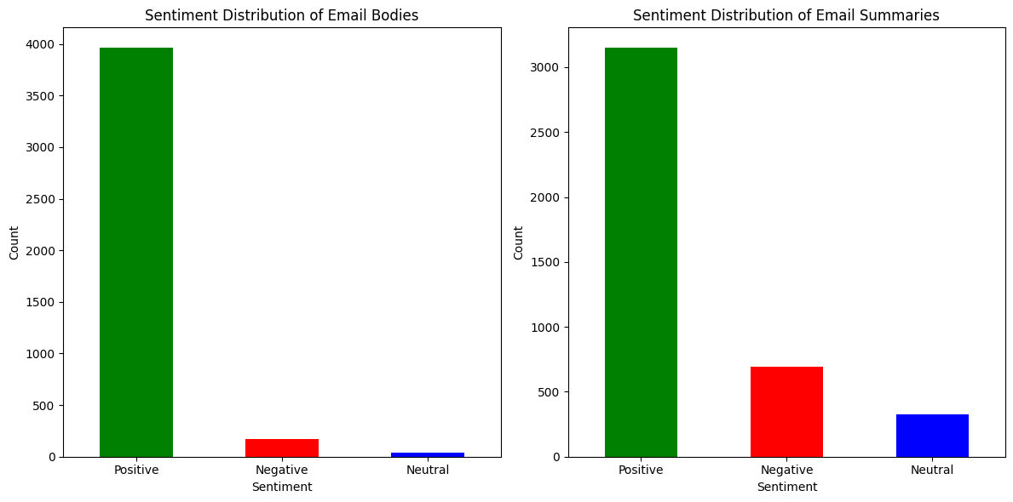

Slide 6
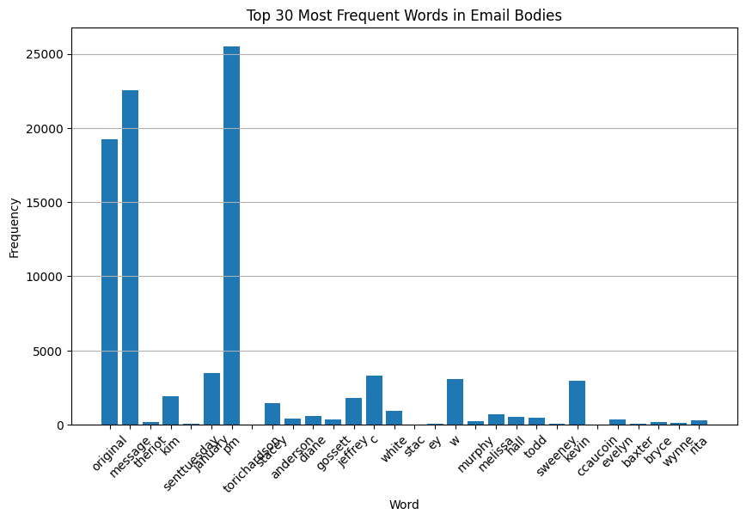

Slide 7
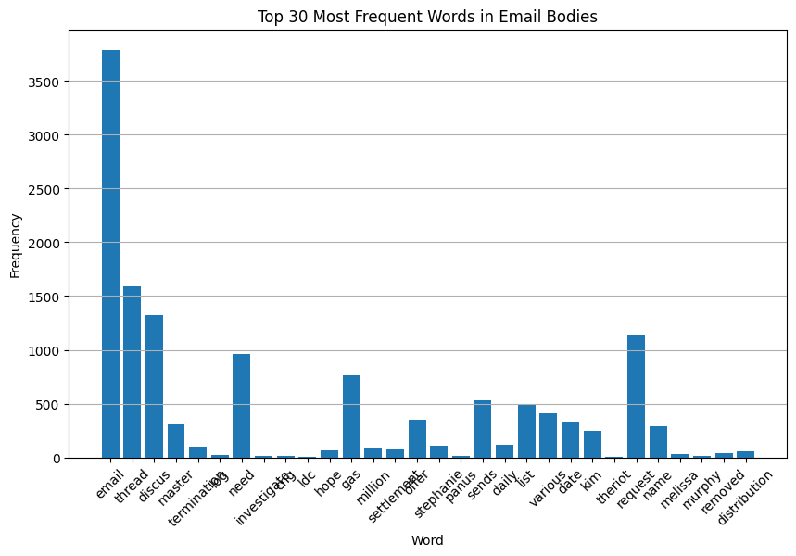

Slide 8
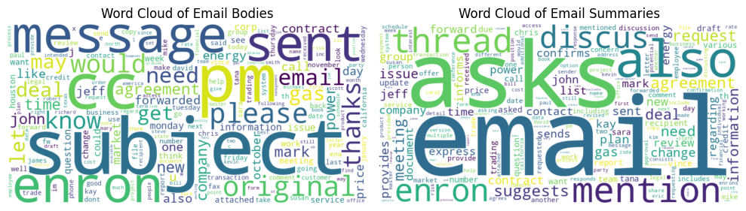

Slide 9
Milestone 2
Shuffling the dataset for randomness
Splitting into training and testing sets (80/20 split)
Tokenization and padding of sequences using Keras
Preprocessing of the input
Notes:
For Milestone 2, we focused on preprocessing the input. We started by shuffling the dataset to ensure randomness and avoid any order bias. We then split the data into training and testing sets, with 80% allocated for training and 20% for testing. This ensures a robust evaluation of our model's performance. Tokenization was performed using Keras, converting text data into sequences of integers. Finally, we padded these sequences to ensure uniform length, a necessary step for training our model

Slide 10
Milestone 2
Abstractive summarization model
Sequence-to-sequence (Seq2Seq) architecture with LSTM layers
Encoder-decoder structure for generating summaries
Architecture of the model
Notes:
Our model for Milestone 2 is an abstractive summarization model, which means it generates new sentences rather than selecting existing ones from the input text. We used a sequence-to-sequence (Seq2Seq) architecture with LSTM layers, consisting of an encoder and a decoder. The encoder processes the input sequence and compresses it into a context vector. This vector is then used by the decoder to generate the output sequence, producing summaries that are coherent and capture the essence of the original text.

Slide 11
Milestone 2
Limitations: dependency on large amounts of data, computationally expensive
Advantages: flexible, human-like summaries
Complexity: high due to LSTM-based Seq2Seq models
Interpretability: challenging, attention mechanisms help
Evaluation
Notes:
Evaluating our model revealed some limitations and advantages. One major limitation is the dependency on large amounts of paired data, making the training process time-consuming and computationally expensive. However, the model offers flexibility, generating human-like summaries that are concise and coherent. The complexity is high, mainly due to the LSTM-based Seq2Seq architecture. Interpretability remains a challenge, but incorporating attention mechanisms can provide insights into the model's decision-making process.

Slide 12
Milestone 3
Chose T5 model for summarization
Comparison with BERTSUMABS and PEGASUS
Advantages: versatility, performance, efficiency
Selection of the pretrained model
Notes:
For Milestone 3, we selected the T5 model for summarization. Compared to other pretrained models like BERTSUMABS and PEGASUS, T5 offers significant advantages. It treats every NLP task as a text-to-text problem, simplifying the task formulation. T5, especially the 't5-small' variant, strikes a balance between performance and efficiency, making it an ideal choice for our implementation. It offers faster training times and lower computational complexity while achieving high-quality summaries.

Slide 13
Milestone 3
T5 model architecture
Encoder-decoder structure with self-attention mechanisms
Training with SimpleTransformers library
Architecture of the model
Notes:
Our chosen model for Milestone 3 is based on the T5 architecture, designed for various text generation tasks. T5's encoder-decoder structure uses self-attention mechanisms to handle long-range dependencies. During training, the encoder converts the input text into hidden states, which the decoder then uses to generate the output text. We used the SimpleTransformers library to streamline the training process, specifying parameters like sequence length, batch size, and number of epochs to control the training behavior.

Slide 14
Milestone 3
Reading and merging CSV files into DataFrames
Converting text to lowercase for consistency
Splitting into training, validation, and test sets
Preprocessing of the input
Notes:
For preprocessing in Milestone 3, we read two CSV files containing email thread details and summaries into Pandas DataFrames. We merged these datasets on the 'thread-id' column to align the email bodies with their summaries. Next, we converted the text to lowercase to maintain consistency and reduce variability. We also ensured data integrity by removing rows with missing values. Finally, we split the dataset into training, validation, and test sets, ensuring that the model is trained and validated on separate portions of the data.

Slide 15
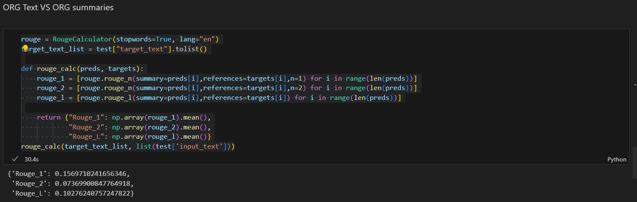
Evaluation

Slide 16
Milestone 3
Requires large amounts of high-quality paired data
Training is computationally expensive and time-consuming,
Abstractive models like T5 can generate factually inaccurate or irrelevant summaries if context is not captured correctly.
Limitations
Notes:
For preprocessing in Milestone 3, we read two CSV files containing email thread details and summaries into Pandas DataFrames. We merged these datasets on the 'thread-id' column to align the email bodies with their summaries. Next, we converted the text to lowercase to maintain consistency and reduce variability. We also ensured data integrity by removing rows with missing values. Finally, we split the dataset into training, validation, and test sets, ensuring that the model is trained and validated on separate portions of the data.

Slide 17
Milestone 3
T5’s Transformer-based encoder-decoder structure is complex due to self-attention mechanisms and handling long-range dependencies.
SimpleTransformers Library: Abstracts much of the complexity, easing implementation and training.
Complexity
Notes:
For preprocessing in Milestone 3, we read two CSV files containing email thread details and summaries into Pandas DataFrames. We merged these datasets on the 'thread-id' column to align the email bodies with their summaries. Next, we converted the text to lowercase to maintain consistency and reduce variability. We also ensured data integrity by removing rows with missing values. Finally, we split the dataset into training, validation, and test sets, ensuring that the model is trained and validated on separate portions of the data.

Slide 18
Milestone 3
Black-Box Nature: Neural network models like T5 are often considered black boxes, making decision processes hard to understand.
Attention Mechanisms: Provide some insights into which parts of the input text the model focuses on, aiding interpretability but not fully resolving the challenge.
Interpretability
Notes:
For preprocessing in Milestone 3, we read two CSV files containing email thread details and summaries into Pandas DataFrames. We merged these datasets on the 'thread-id' column to align the email bodies with their summaries. Next, we converted the text to lowercase to maintain consistency and reduce variability. We also ensured data integrity by removing rows with missing values. Finally, we split the dataset into training, validation, and test sets, ensuring that the model is trained and validated on separate portions of the data.

Slide 19
Findings and Limitations
Findings: NLP enhances information accessibility, effective text summarization.
Limitations: Data quality, computational resources, generalization challenges.
Notes:
Our project findings demonstrate that NLP significantly enhances information accessibility, with effective text summarization making large volumes of text manageable. However, we faced limitations due to the quality of the summaries provided in the dataset, as indicated by our evaluation metrics: ROUGE-1 scored 0.15, ROUGE-2 scored 0.07, and ROUGE-L scored 0.10. This indicates the summaries were not optimal, affecting our training results. Additionally, we encountered challenges with the dependency on large amounts of high-quality data, the substantial computational resources needed for training, and difficulties with generalization to unseen data. Despite these limitations, the advantages of NLP in improving information consumption are clear.

Slide 20
Conclusion
NLP’s role in addressing information overload
Future potential and impact on digital information consumption
Contribution to making knowledge more accessible
Notes:
In conclusion, our project showcases NLP's crucial role in addressing the pervasive problem of information overload. By developing effective text summarization models, we can make digital information consumption more efficient and accessible. The potential impact of NLP in this field is immense, promising to revolutionize how we interact with and understand vast amounts of information. This project contributes to making knowledge more accessible, helping users quickly grasp essential insights without sifting through extensive content.

